Slide 1



PROJECT DESIGN REPORT Teksus TELECOMMUNICATIONS DATABASE SYSTEM
ADITYA TORNEKAR

Slide 2
PROJECT GOALS:
DATA COLLECTION:
A customer opens an account when he subscribes to a product offered by the organization.
This product might have an offer during campaigns carried out by the organization.
Once a customer has an account, billing details along with all the other data from the above process is stored in the database.
CUSTOMER LOCATION DATA
SUBSCRIBER DATA
BILLING
DATA
CAMPAIGN DATA
DATA
PROD-CAMP
DATA
PRODUCT
DATA
ACCOUNT DATA
ORDER DATA
OFFER DATA

Slide 3
PROJECT GOALS:
USERS WHO CAN POPULATE DATABASE:
Mainly, a sales representative collects the data from the customer and feeds the data in the database using a form structure(GUI).
A customer can enter his own details using the website if he subscribes to OTT services which is similar to creating an account on Netflix/Amazon Prime.
CDO team and Development team populate the campaign and internal data.
SALES REPRESNTATIVE
DATABASE DEVELOPMENT TEAM
CHIEF DATA OFFICE TEAM
CUSTOMER

Slide 4
PROJECT GOALS:
WHO CAN QUERY THE DATA:
The CDO team holds full access on the database and they usually query a database for optimization and maintenance purposes.
Reporting teams query database for generating dashboards and reports.
Marketing teams use database for checking campaign data & product-customer historical data.
Sales teams use database to help customers with better product choices for increasing sales.
Database development team uses database to understand the existing architecture when they have to integrate data for new products.
Customers can use database to retrieve billing details and subscription details.
CDO TEAM
DATABASE DEVELOPMENT TEAM
REPORTING TEAM
MARKETING TEAM
SALES TEAM
CUSTOMERS

Slide 5
MAJOR DATA QUESTIONS:
Which product is most subscribed?
Product Data
Which city has the maximum customers?
Customer Location Data
Billing Data
What is the preferred billing option?

Slide 6
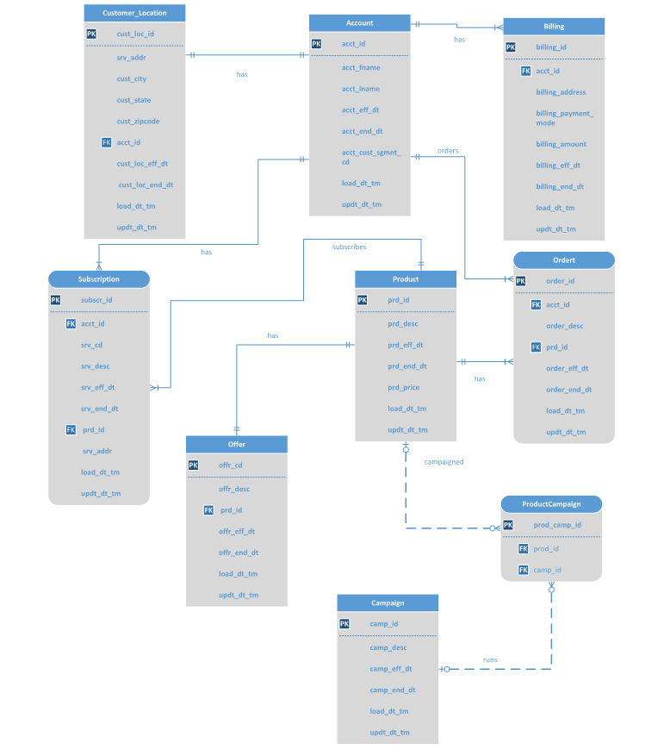
ENTITY RELATIONSHIP DIAGRAM VISIO:

Slide 7
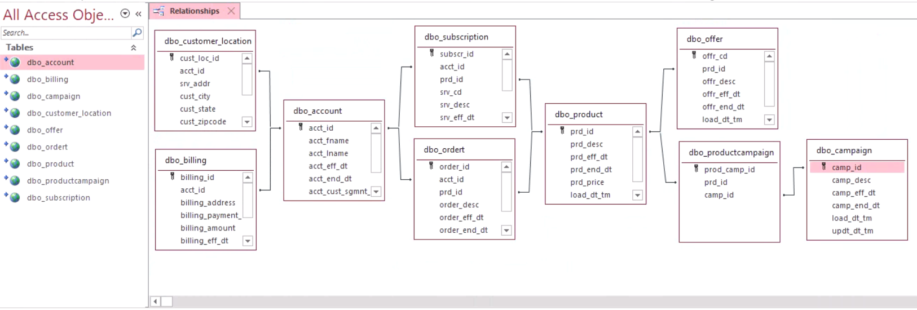
ENTITY RELATIONSHIP DIAGRAM MS ACCESS:

Slide 8
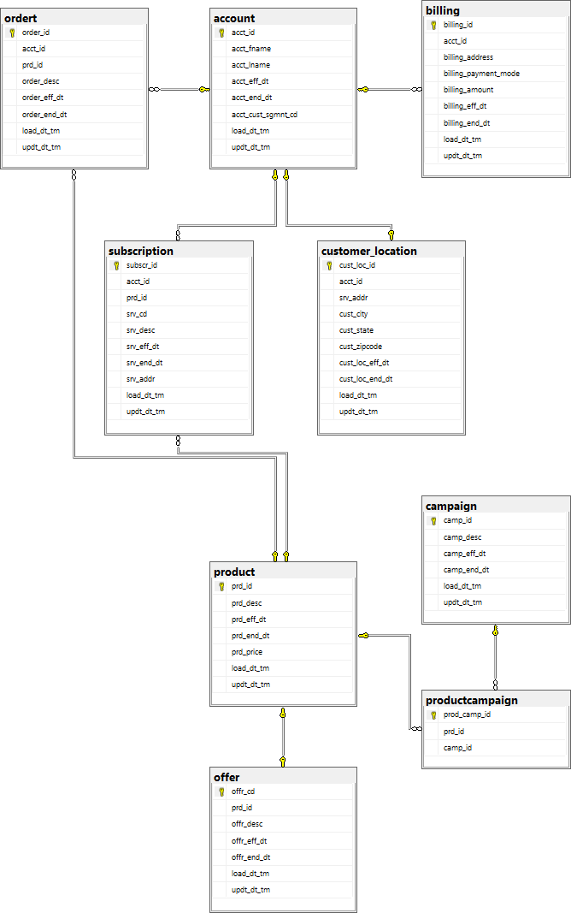
ENTITY RELATIONSHIP DIAGRAM MICROSOFT SQL SERVER:

Slide 9
FORMS
Total Number of Tables: 9
Total Number of Forms: 9
Account Form : Enables you to view/update data in account table.(Y)
Product Form : Enables you to view/update available products in the system.(Y)
Offer Form : Enables you to view/update available offers on the products.(Y)
Campaign Form: Enables you to view/update campaign details in the system.(Y)
Order Form: Enables you to view/update order details in the system.(Y)
Billing Form: Enables you to view/update billing details in the system.(Y)
Subscription Form: Allows you to check subscribed products by an account.(Y)
Account_Subscription_Product Form: Allows you to view combined data for account, subscription and product table.(Sub-Form)(Y)
Customer Location Form: Allows you to check/update customer location details. (Combo Box for customer state)(Y)

Slide 10
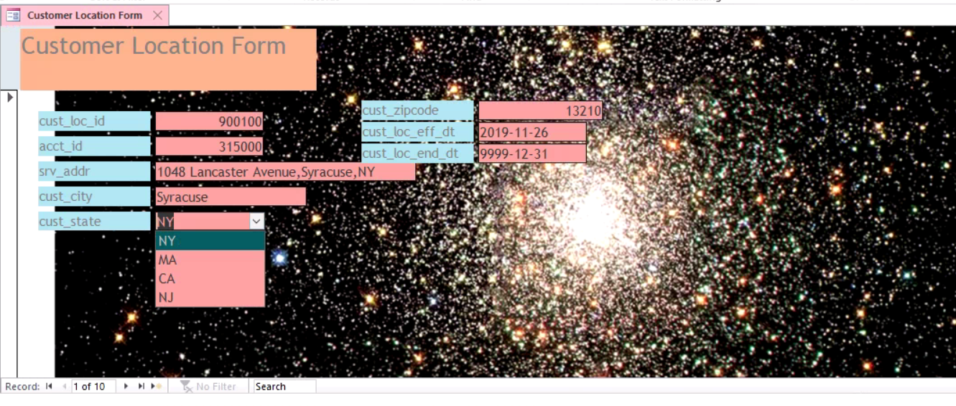
Customer Location Form: Combo Box for choosing cust_state

Slide 11
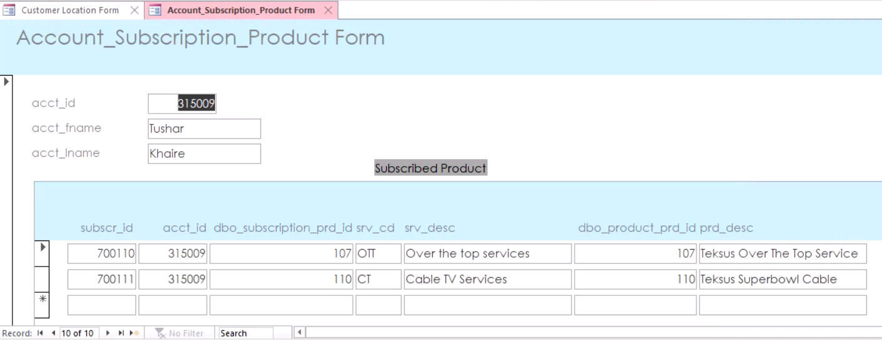
Account_Subscription_Product Form: This form consists of sub-form for subscription and product data based on account data.

Slide 12
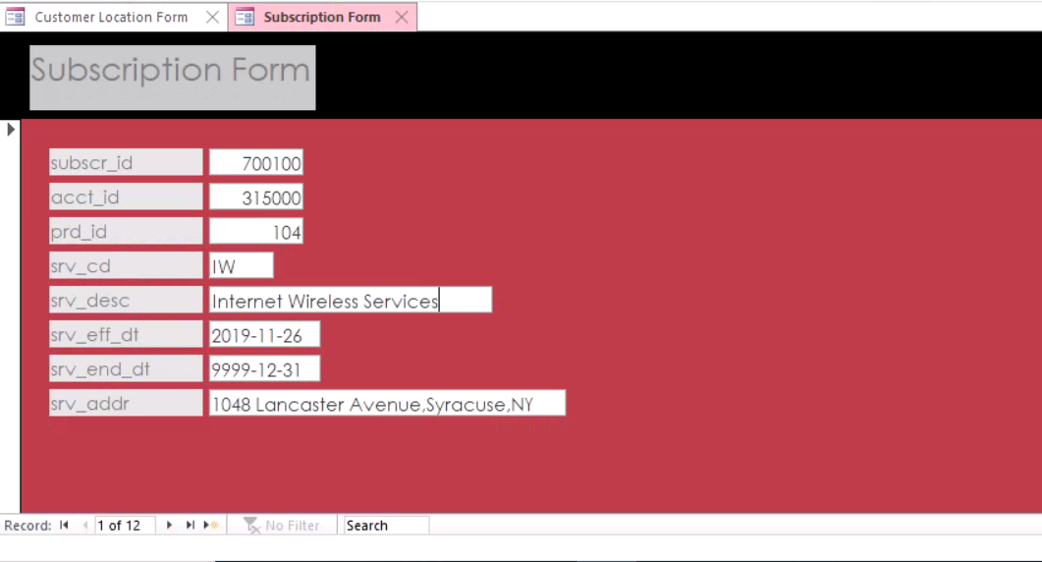
Subscription Form:

Slide 13
MAJOR DATA QUESTIONS - REPORTS
Which product is most subscribed?(Y)
Which city has the maximum customers?(Y)
What is the preferred billing option?(Y)

Slide 14
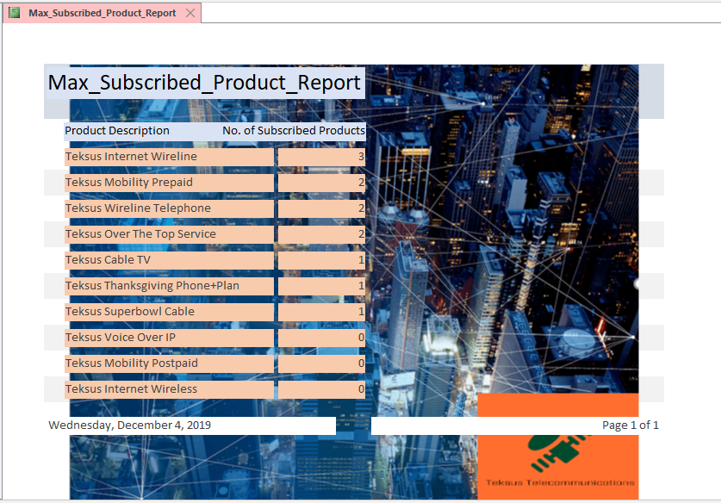
REPORT1: Which product is most subscribed?

Slide 15
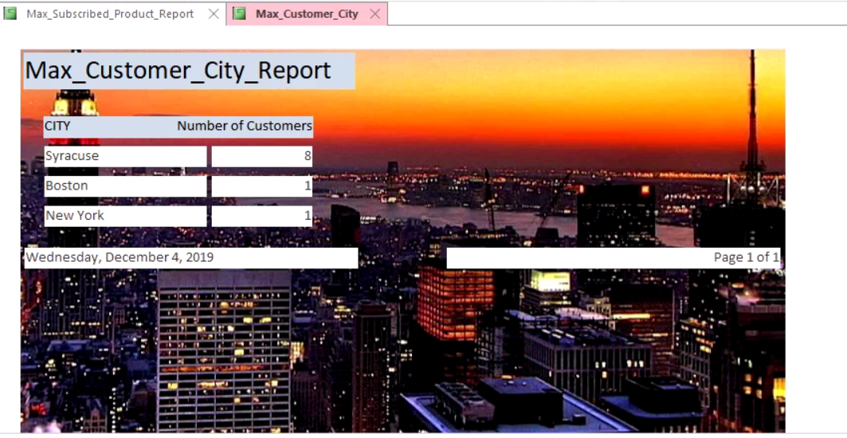
REPORT2: Which city has the maximum customers?

Slide 16
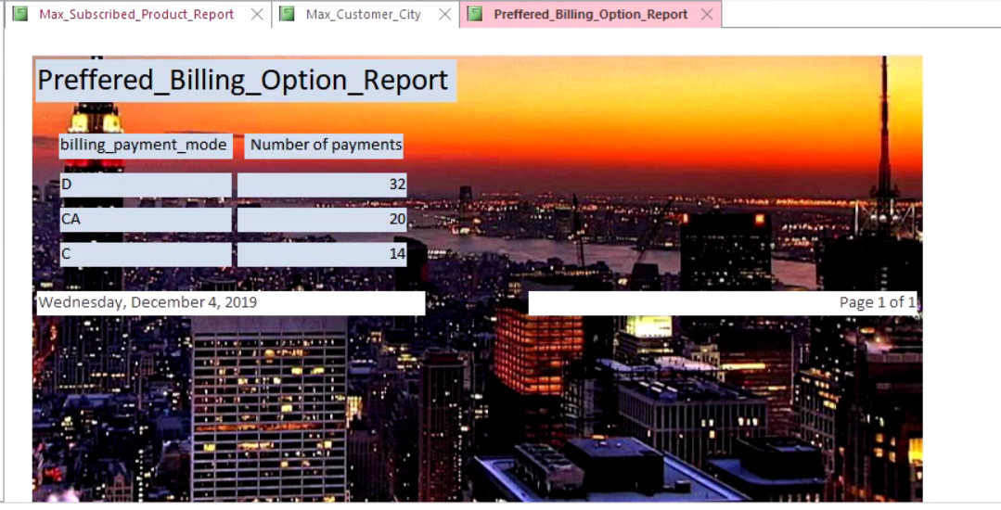
REPORT3: What is the preferred billing option?

Slide 17
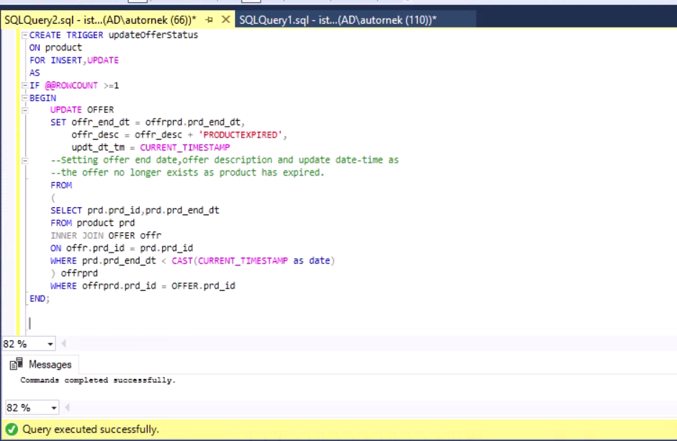
TRIGGER This trigger updates the offer end date in the offer table when product table is updated in case the product is expired.

Slide 18
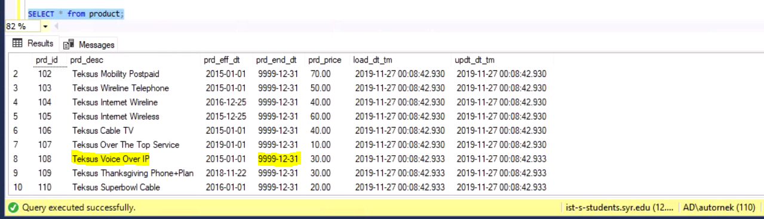
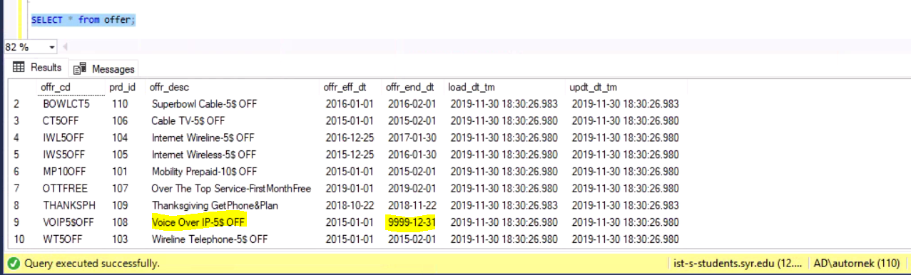
Before product expiry date is updated

Slide 19
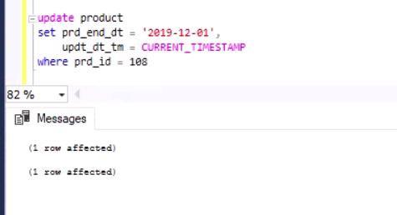
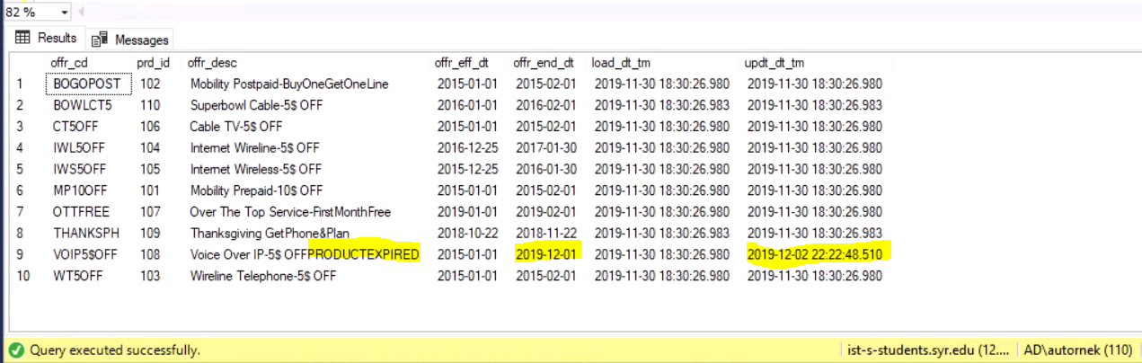
After product table(expiry) is updated the trigger updates the offer table.

Slide 20
THANK YOU

